Slide 1



Business Impact Presentation 3/11/2015
How VMTurbo will help First Data Transform the payments industry

Slide 2

VMTURBO Background
Founded 2009
Founding team from SMARTS (Acquired by EMC)
Backed by Bain Capital Ventures and Highland Capital Partners
Award-winning control system for virtualized and cloud environments
First product released VMTURBO Operations Manager
launched in September 2010
15,000+ users worldwide; 1,000+ customers
180+ employees (doubled over the past 9 months)

Slide 3



































Slide 4
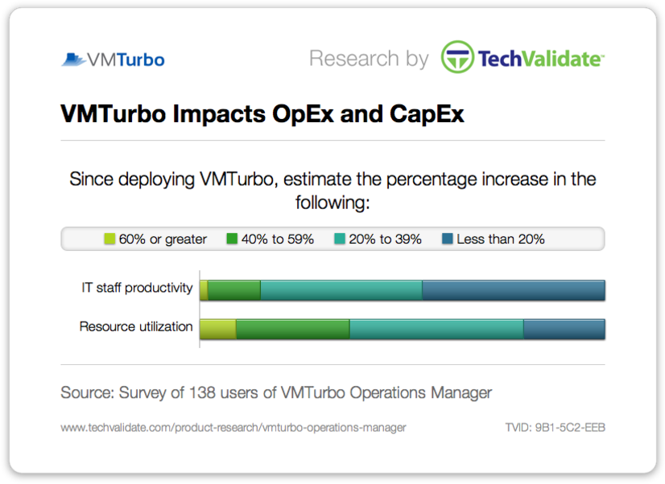
VMTurbo Improves CAPEX and OPEX
55% of customers increased IT staff productivity by 20% or more since deploying VMTurbo
VMTurbo Impacts CapEx
VMTurbo Impacts OpEx
: 9%
: 28%
: 43%
: 20%
: 2%
: 13%
: 40%
: 45%
80% of customers increased resource utilization by 20% or more since deploying VMTurbo

Slide 5
Agenda:
First Data’s Business Challenges
First Data’s Key Requirements to meet these challenges
POV Overview
ROI Presentation
VMTurbo Competitive comparison
Proposal Discussion
Appendix (ROI Numbers confirmed through plans)

Slide 6
Who From First Data has tested VMTurbo?
Solutions Engineering
Platform design engineering
Capacity Management
Service Delivery
& Other Business Units
Licensing
Architecture
Service Delivery
Sourcing
Tools Team

Slide 7
Platform design engineering
Capacity Management
Team Members:
George Fiedorowicz, John Bridgeman, Hank Orofino, Danisue Gilpin, and Brett Wyer
Business Challenges:
First Data has a very complex virtual environment with several performance challenges leading to outages and overspending on hardware.
First Data currently receives thousands of alerts due to performance and is in a reactive state.
First Data has some clusters that are over provisioned, other clusters are under provisioned and cannot determine placement and sizing of VMs across the infrastructure.
First Data is currently exploring hypervisor alternatives as a part of the IT Strategy moving forward and doesn’t have a hypervisor agnostic approach to manage the environment.

Slide 8
Capacity Management
Team Members:
Scott Cavanaugh, Joan Stone, Roger Ortega, Bob Campano
Business Challenges:
Currently doesn’t have an effective way to plan for changes while keeping the environment healthy.
First Data currently cannot determine when additional hardware is needed and provide procurement with accurate lead time to receive new hardware.
Gap between Capacity Management, Service delivery, and Platform design teams leads to increased time spent planning.
Reserve and deploy new workloads without disruption

Slide 9
Platform design engineering
Capacity Management
Service Delivery
& Other Business Units
Team Members:
Julie Walker, David Halbig, Mark Preston, Nathan Walsh, Alfredo Perez, Robin Burris and Karen O’Neil, Johnson Rajakumar, Duc Chu, Dameon Horner
Business Challenges:
Due to performance problems with the SQL environment, the Capacity planning group needs to move VMs around the environment manually to make sure they are getting the performance needed. Often, the moves are going to HW that is not licensed for SQL. This has led to significantly overspending on licensing for the SQL environment.
First Data uses HP automation suite to provision additional blades when needed but cannot determine when clusters need additional blades. Furthermore, First Data cannot determine what clusters have access compute to repurpose for other clusters.
First Data has significantly overspent on infrastructure to assure application performance.
First Data has been growing historically at 20% or more over the last several years which leads to an increased time spent managing while downsizing the IT staff.

Slide 10
Platform design engineering
Capacity Management
Service Delivery & Other Groups
Business & Technical Criteria

Slide 11
Business Challenges:
First Data has a very complex virtual environment with several performance challenges leading to outages and overspending on hardware.
Several different groups managing different aspects of IT, some of which are being eliminated due to office consolidation.
Overspending on SQL Licensing due to dynamic nature of SQL & other virtual machines impacting workload.
Currently does not have an effective way to plan for changes while keeping the environment healthy.
Has been growing historically around 20% which further increases complexity and spend.
First Data uses HP Automation suite but currently cannot leverage excess capacity in other clusters to determine where HW should be provisioned.

Slide 12
Agenda:
First Data’s Business Challenges
First Data’s Key Requirements to meet these challenges
POV Overview
ROI Presentation
VMTurbo Competitive comparison
Proposal Discussion
Appendix (ROI Numbers confirmed through plans)

Slide 13
Requirements:
First Data needs a “get well plan” – road map to intelligently place and size all virtual machines across existing infrastructure while understanding the underlying capacity.
First data needs to then “stay well” – First Data needs a solution that will keep the virtual environment healthy through decision automation. As workloads change, First Data will need a solution that will continuously asses the virtual environment and make sizing and placement decisions simultaneously while understanding the capacity.
First Data needs a solution that will accurately plan for changes in the environment while keeping the environment healthy.
First Data needs a solution that will identify areas of excess capacity, move VMs off of the host, and integrate with their current HP Automation suite to use extra hardware in other clusters that need it.
First Data needs a solution that can scale to over 8,000 VMs and 748 hosts while growing at 20% year over year and can also incorporate their VDI and Citrix environments in order to improve operational efficiency.
First Data needs a solution that will Assure application performance while understanding SQL Licensing constraints so they no longer need to over spend on SQL Licensing for the virtual environment.

Slide 14
Agenda:
First Data’s Business Challenges
First Data’s Key Requirements to meet these challenges
POV Overview
ROI Presentation
VMTurbo Competitive comparison
Proposal Discussion
Appendix (ROI Numbers confirmed through plans)

Slide 15
Testing VMTurbo:
During the POV with VMTurbo, First Data proved out the following use cases:
Scalability & Improving Operational Efficiency: First Data successfully deployed VMTurbo in the largest vCenter.
Get Well Plan: VMTurbo successfully delivered a “Get Well Plan”.
Stay Well: VMTurbo showed First Data in a test cluster how to keep the environment healthy
Planning: VMTurbo showed First Data how to accurately plan for changes while keeping the environment healthy.
Integration with HP Automation Suite
SQL Licensing: conversation and demonstration with Licensing team

Slide 16
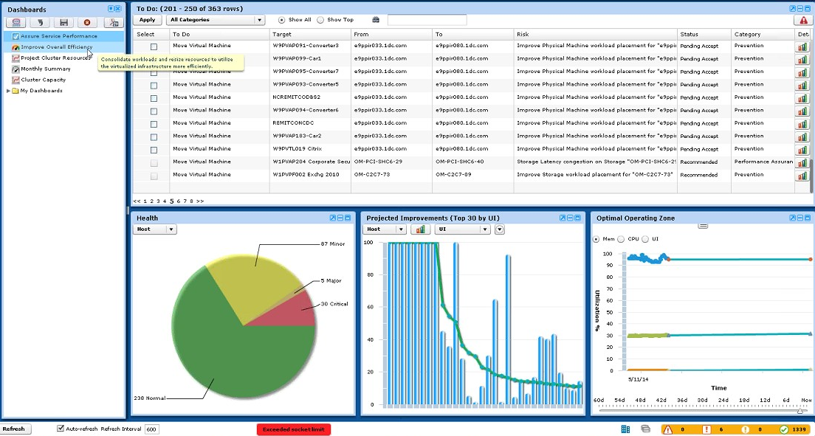
Testing VMTurbo: Scalability & Improving Operational Efficiency
Infinite scalability
Minimal footprint
Quick discovery
Multi tenant
Hypervisor & HW agnostic
Extensible architecture

Slide 17
Testing VMTurbo:
During the POV with VMTurbo, First Data proved out the following use cases:
Scalability & Improving Operational Efficiency: First Data successfully deployed VMTurbo in the largest vCenter.
Get Well Plan: VMTurbo successfully delivered a “Get Well Plan”.
Stay Well: VMTurbo showed First Data in a test cluster how to keep the environment healthy
Planning: VMTurbo showed First Data how to accurately plan for changes while keeping the environment healthy.
Integration with HP Automation Suite
SQL Licensing: conversation and demonstration with Licensing team

Slide 18
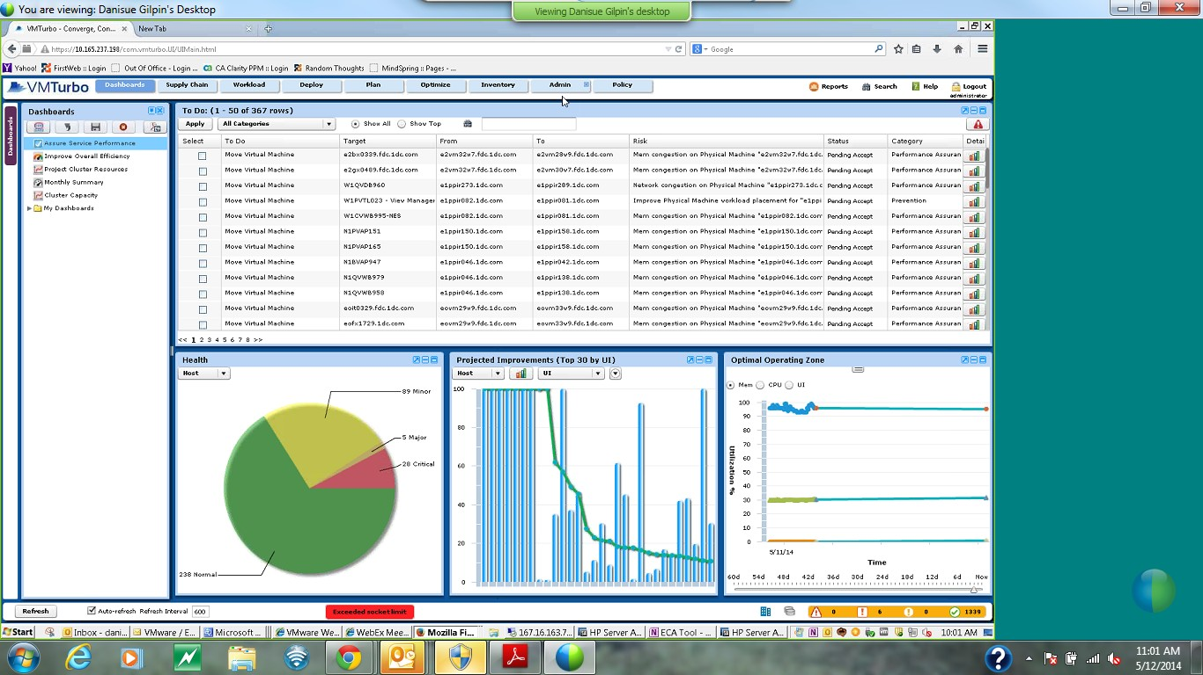
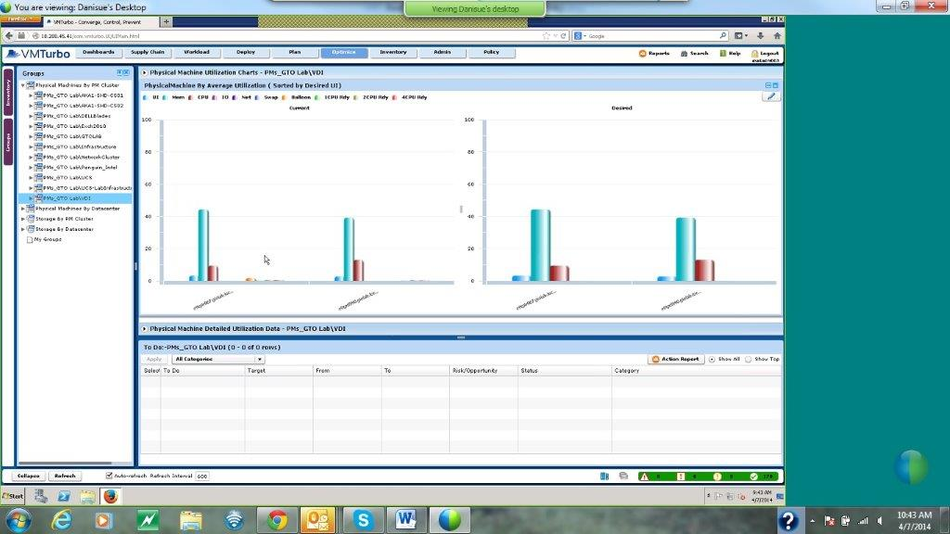
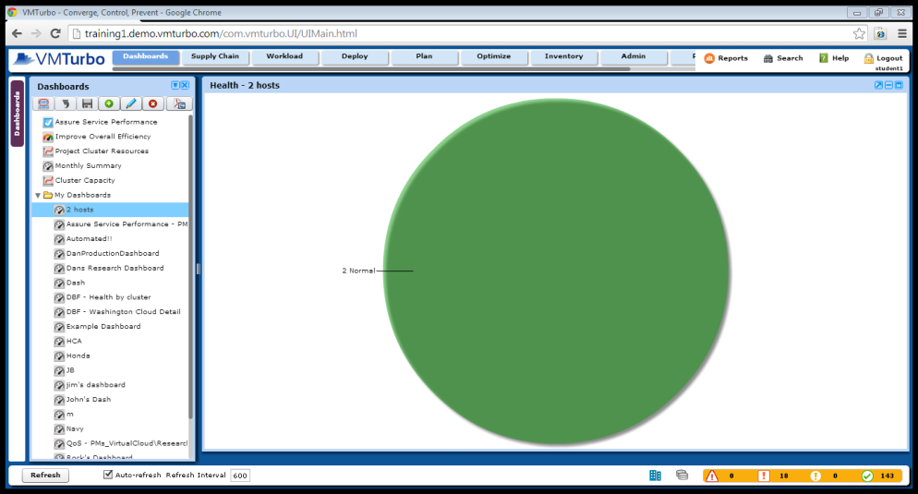
Testing VMTurbo: “Get Well Plan”
During the POV, VMTurbo identified 367 recommendations that can be applied (manually or in automate) to move the environment into a healthy state. Both placement & sizing recommendations simultaneously with an understanding of capacity.
Testing Recommendations: GTO Lab\ VDI
Current State of First Data’s Environment BEFORE VMTURBO
Cluster in Automate, all hosts are converged, environment has been kept healthy throughout entire POV

Slide 19
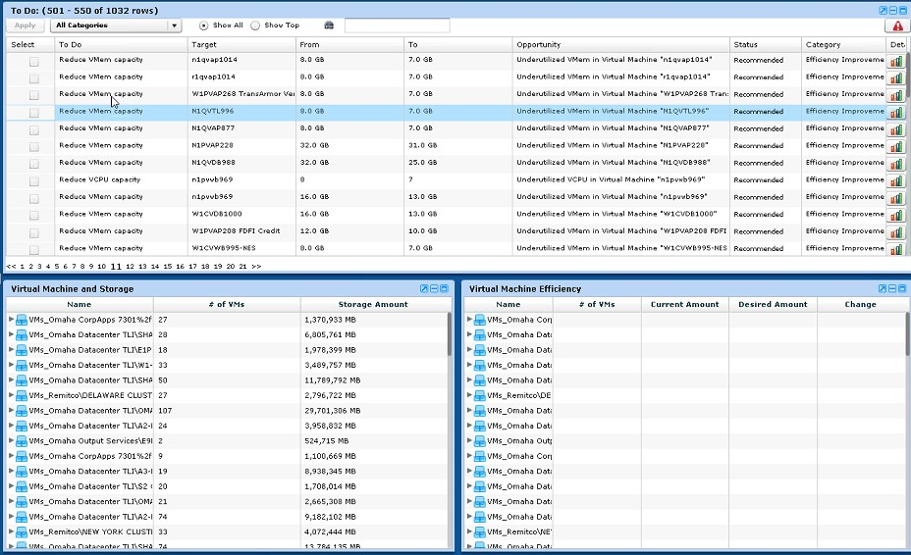
Testing VMTurbo: “Get Well Plan” Continued…
VMTurbo identified 1032 areas of over provisioned virtual machines and showed how to appropriately size them.
VMTurbo is the only solution that makes placement and sizing recommendations simultaneously.

Slide 20
Testing VMTurbo:
During the POV with VMTurbo, First Data proved out the following use cases:
Scalability & Improving Operational Efficiency: First Data successfully deployed VMTurbo in the largest vCenter.
Get Well Plan: VMTurbo successfully delivered a “Get Well Plan”.
Stay Well: VMTurbo showed First Data in a test cluster how to keep the environment healthy
Planning: VMTurbo showed First Data how to accurately plan for changes while keeping the environment healthy.
Integration with HP Automation Suite
SQL Licensing: conversation and demonstration with Licensing team

Slide 21
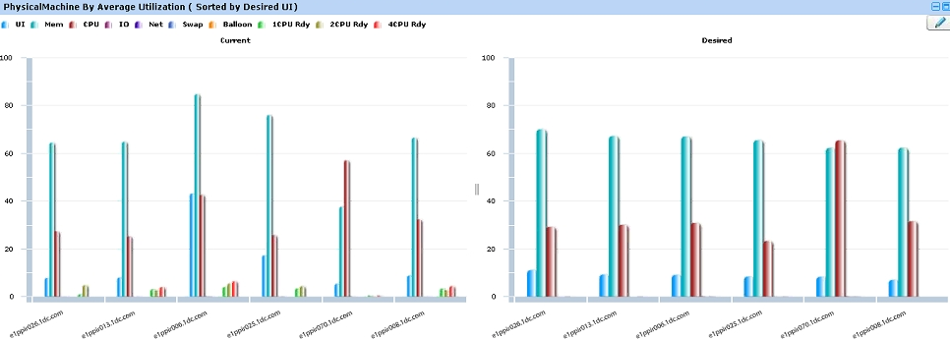
Testing VMTurbo: “Stay Well Plan”
During the POV, Fist Data has automated VMTurbo’s recommendations in the test cluster to show that VMTurbo can keep First Data Healthy.
VMTurbo will continuously asses the environment and will intelligently place and size VMs across the infrastructure to keep each cluster converged across all compute resources.
6 Hosts Normal
Risk
BEFORE
AFTER
Automation
Output

Slide 22
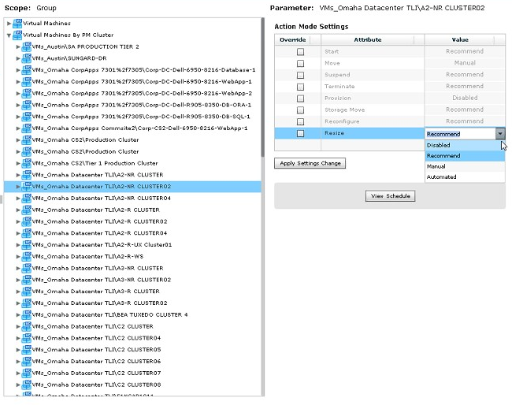
Testing VMTurbo: “Stay Well Plan”
First Data has the ability to chose various actions around Keeping the environment healthy:
Automate: will keep the environment healthy, automatically apply the recommendation as soon as VMTurbo determines a change
Manual: ability to click the recommendations and hit apply
Recommend: read recommendations to keep environment healthy
Schedule: ability to schedule changes during maintenance windows.
Recommendations around:
vMotion
Storage vMotion
Resize
Control Options:
All VMs
By Cluster
By Network
By Storage
By Folders
By individual groups that Frist Data can create

Slide 23
Testing VMTurbo:
During the POV with VMTurbo, First Data proved out the following use cases:
Scalability & Improving Operational Efficiency: First Data successfully deployed VMTurbo in the largest vCenter.
Get Well Plan: VMTurbo successfully delivered a “Get Well Plan”.
Stay Well: VMTurbo showed First Data in a test cluster how to keep the environment healthy
Planning: VMTurbo showed First Data how to accurately plan for changes while keeping the environment healthy.
Integration with HP Automation Suite
SQL Licensing: conversation and demonstration with Licensing team

Slide 24
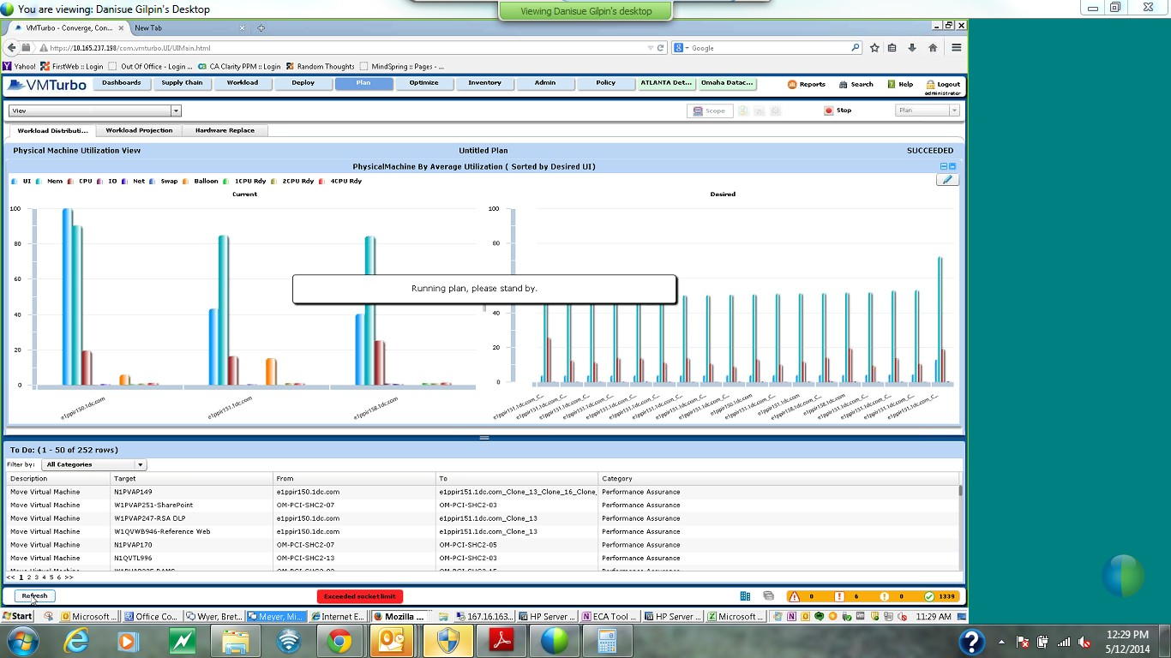
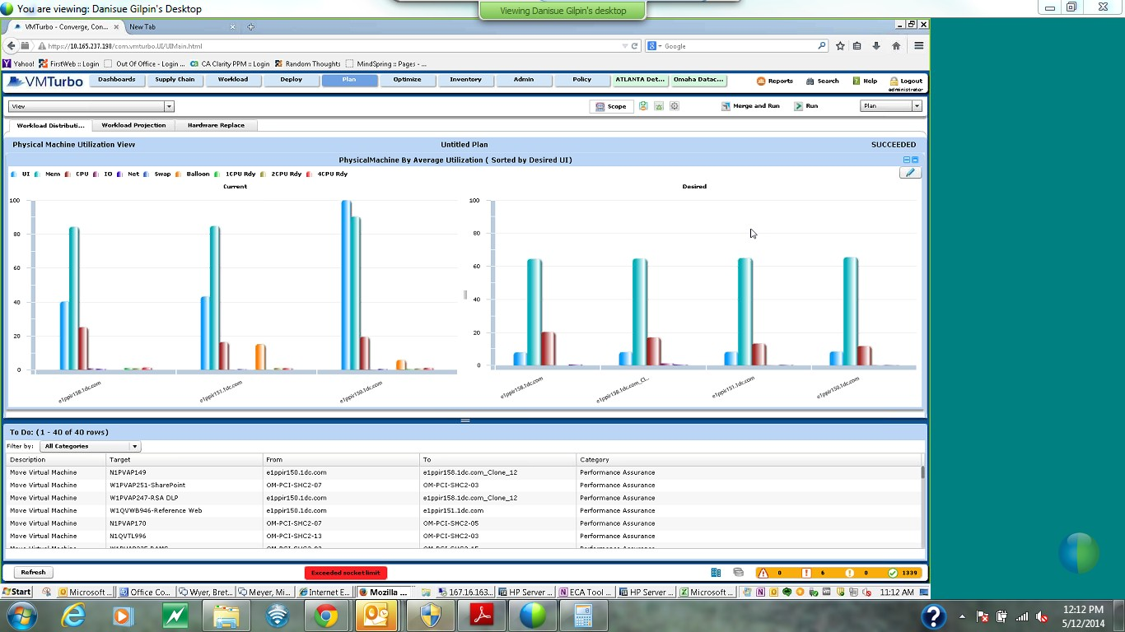
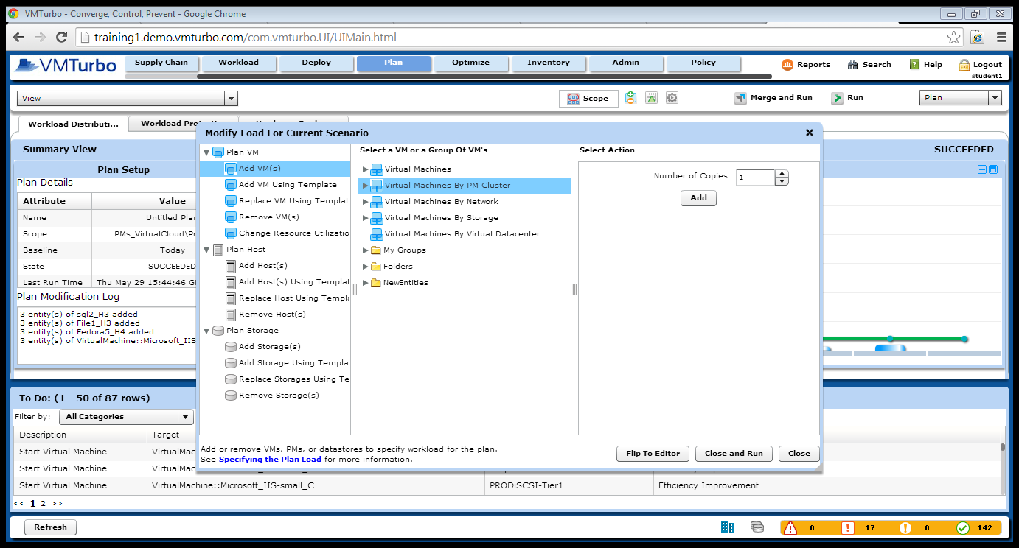
Testing VMTurbo: Planning: VMTurbo showed First Data how to accurately plan for changes while keeping the environment healthy.
Once First Data simulates the changes to their environment, VMTurbo will help them keep the environment healthy and manage the simulation once they are ready to move forward with the changes.

Slide 25
Testing VMTurbo:
During the POV with VMTurbo, First Data proved out the following use cases:
Scalability & Improving Operational Efficiency: First Data successfully deployed VMTurbo in the largest vCenter.
Get Well Plan: VMTurbo successfully delivered a “Get Well Plan”.
Stay Well: VMTurbo showed First Data in a test cluster how to keep the environment healthy
Planning: VMTurbo showed First Data how to accurately plan for changes while keeping the environment healthy.
Integration with HP Automation Suite
SQL Licensing: conversation and demonstration with Licensing team

Slide 26
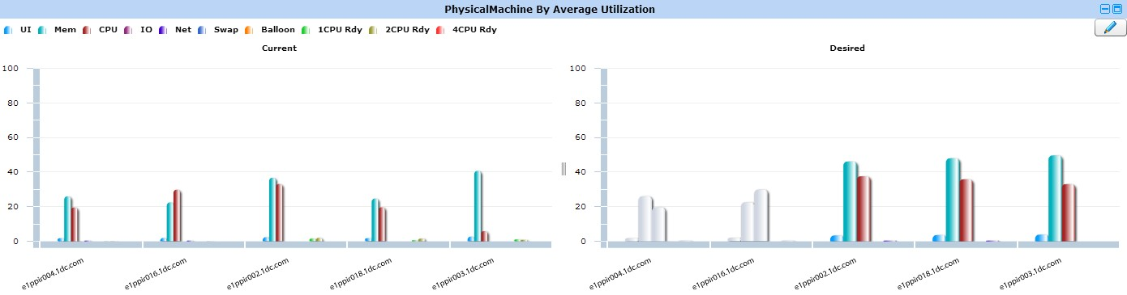

Testing VMTurbo: HP Automation Suite
VMTurbo recommends Host Suspension based on cluster(s) utilization
VMTurbo recommends to add additional host to cluster if it can no longer assure application performance
VMTurbo automatically moves VMs off of host to other existing hosts
VMTurbo notifies HP Automation suite of available host
HP Automation suite then shuts down host and de provisions host
VMTurbo tells HP Automation Suite that it needs another host
HP Automation suite then powers on and provisions host to cluster
VMTurbo then redistributes the VMs based on all compute metrics

Slide 27
Testing VMTurbo:
During the POV with VMTurbo, First Data proved out the following use cases:
Scalability & Improving Operational Efficiency: First Data successfully deployed VMTurbo in the largest vCenter.
Get Well Plan: VMTurbo successfully delivered a “Get Well Plan”.
Stay Well: VMTurbo showed First Data in a test cluster how to keep the environment healthy
Planning: VMTurbo showed First Data how to accurately plan for changes while keeping the environment healthy.
Integration with HP Automation Suite
SQL Licensing: conversation and demonstration with Licensing team

Slide 28
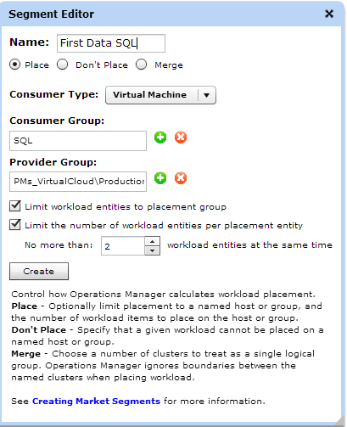
Testing VMTurbo: SQL Licensing Compliance
“Due to the nature of our VM environment, there are difficulties with tracking licensing for database software and other software products which base their compliance on Processor/Core counts. With this tool, they are able to monitor the vMotion transitions and ensure we remain compliant based on the licensing we have.”
- Karen O’Neill
Several clusters First Data has licenses allocated to SQL on several VM servers. When there are performance issues, where the server is taxed vMotion could utilize a higher core count on another VM therefore taking them out of compliance.
Application Performance Assured
SQL Licensing in compliance
Lowered cost in licensing

Slide 29
Agenda:
First Data’s Business Challenges
First Data’s Key Requirements to meet these challenges
POV Overview
ROI Presentation
VMTurbo Competitive comparison
Proposal Discussion
Appendix (ROI Numbers confirmed through plans)

Slide 30
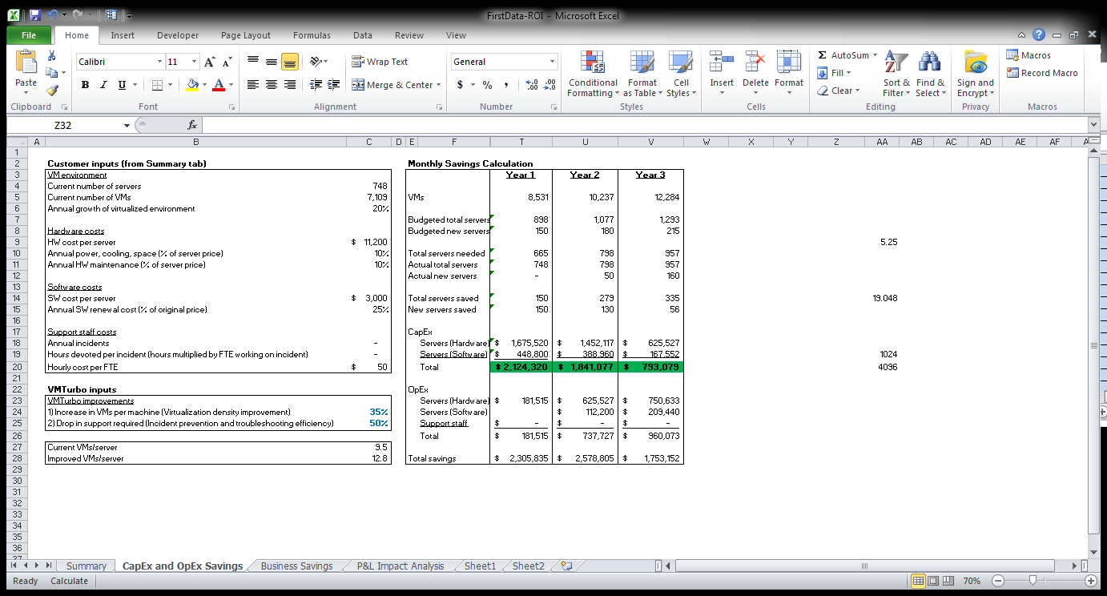
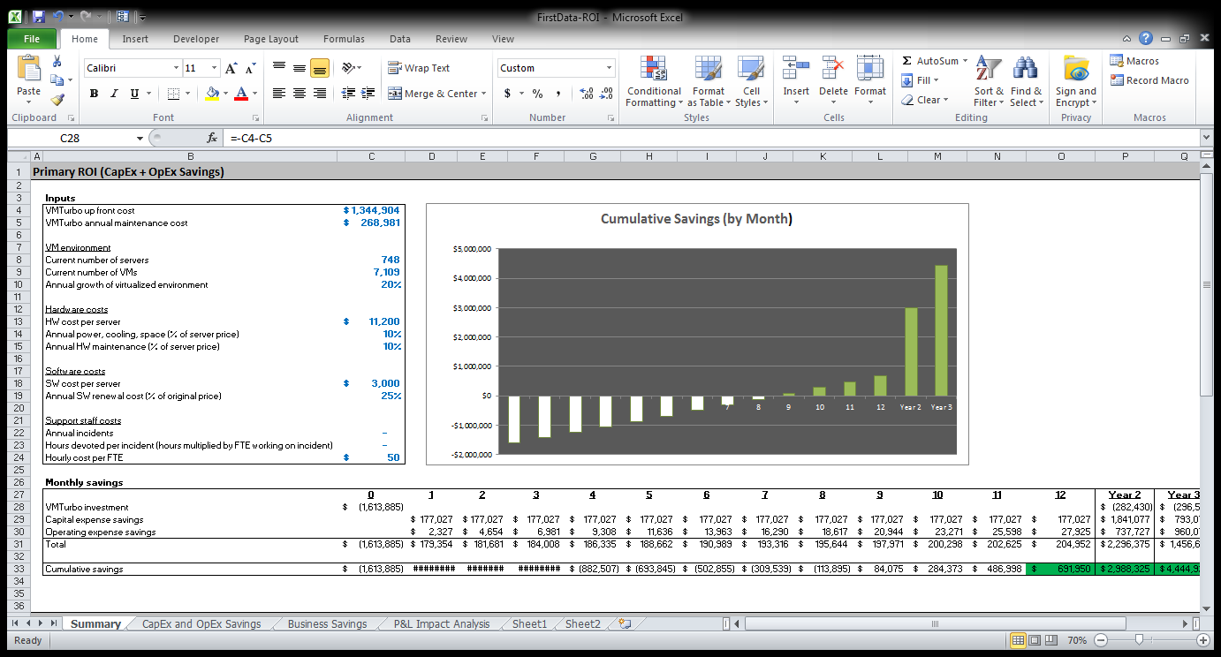
Return on Investment Summary
Projected payback period of 9 months… @35% increase in VM Density.
Proven in POV:
Average VM / Host Density:
51% (used 35%)
See Slide for cluster projections ran

Slide 31
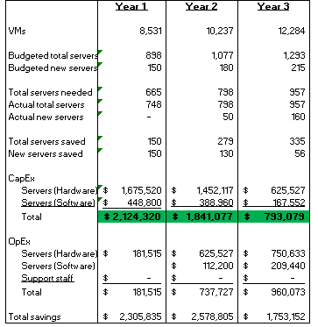
Return on Investment Summary
ROI Key Assumptions…35% increase in VM Density drives 300 less host purchases over 3 years.. $4.7 million savings

Slide 32
Return on Investment Summary
On a P&L basis breakeven in
Year 1 and accretive thereafter

Slide 33
Return on Investment Summary
Confirmed during POV
Note: Year 1 break-even can be achieved with only a 12% - 12.5% increase in VM density
Note: all ROI numbers assume list price (payback period above is from production vCenter)

Slide 34
Agenda:
First Data’s Business Challenges
First Data’s Key Requirements to meet these challenges
POV Overview
ROI Presentation
VMTurbo Competitive comparison
Proposal Discussion
Appendix (ROI Numbers confirmed through plans)

Slide 35

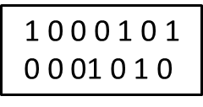


Assure Performance
Application
>
Efficiency
Desired State
Define
Control
Drive
Virtualization enabled us to prevent problems from happening. VMTurbo gives us the recommendations to make sure you do not leave an optimal state
Traditional Tools wait until you have a problem, send you an alert and allow you to troubleshoot and fire fight AFTER you have a problem

Slide 36
 | VMTurbo | vRealize
Operations and Control
Continuously drives actions across the IT stack to control the environment in the desired state | Yes | No
Continuously drives actions across the IT stack to assure application performance | Yes | No
Continuously drives actions across the IT stack to maximize resource utilization | Yes | No
Continuously adapts to workload demand fluctuations | Yes | No
Continuously adapts to infrastructure and workload dependency changes | Yes | No
Configurable service priorities and infrastructure cost policies | Yes | No
Configurable policies controlling real time action execution | Yes | No
Deployment and On Boarding
Controls the environment in the desired state to support workload deployment | Yes | No
Cross hypervisor, data center and cloud deployment | Yes | No
Detailed resource provisioning and workload placement action plans | Yes | No
Intelligent workload placement decisions via workflow integration with 3rd party tools | Yes | No
Rapid Capacity Management & Planning
Controls the environment in the desired state to support future workload growth | Yes | No
Controls the environment in the desired state while refreshing/migrating hardware | Yes | No
Controls the environment in the desired state to support P2V/P2C or V2V migration | Yes | No
Controls the environment in the desired state while reserving for future deployments | Yes | No
Controls the environment in the desired state to support cluster consolidation | Yes | No

Slide 37
 | VMTurbo | vRealize
Cloud Control
Multi tenant support for cloud constructs such as Virtual Data Centers (VDCs) | Yes | No
Control of cloud constructs (VDCs) to assure service levels | Yes | No
Control of cloud constructs (VDCs) to maximize resource usage | Yes | No
Continuously drives actions to control cloud constructs (VDCs) layer in the desired state | Yes | No
Storage Control
Continuously drives actions in the storage layers to control the environment in the desired | Yes | No
state | Yes | No
Continuously drives actions in the storage layers to assure application performance | Yes | No
Continuously drives actions in the storage layers to maximize resource utilization | Yes | No
Fabric Control
Continuously drives actions in the fabric layers to control the environment in the desired state | Yes | No
Continuously drives actions in the fabric layers to assure application performance | Yes | No
Continuously drives actions in the fabric layers to maximize resource utilization | Yes | No
Network Control
Continuously drives actions in the network layers to control the environment in the desired state | Yes | No
Continuously drives actions in the Network layers to assure application performance | Yes | No
Continuously drives actions in the network layers to maximize resource utilization | Yes | No

Slide 38
 | VMTurbo | vRealize
Cloud Control
Multi tenant support for cloud constructs such as Virtual Data Centers (VDCs) | Yes | No
Control of cloud constructs (VDCs) to assure service levels | Yes | No
Control of cloud constructs (VDCs) to maximize resource usage | Yes | No
Continuously drives actions to control cloud constructs (VDCs) layer in the desired state | Yes | No
Storage Control
Continuously drives actions in the storage layers to control the environment in the desired | Yes | No
state | Yes | No
Continuously drives actions in the storage layers to assure application performance | Yes | No
Continuously drives actions in the storage layers to maximize resource utilization | Yes | No
Fabric Control
Continuously drives actions in the fabric layers to control the environment in the desired state | Yes | No
Continuously drives actions in the fabric layers to assure application performance | Yes | No
Continuously drives actions in the fabric layers to maximize resource utilization | Yes | No
Network Control
Continuously drives actions in the network layers to control the environment in the desired state | Yes | No
Continuously drives actions in the Network layers to assure application performance | Yes | No
Continuously drives actions in the network layers to maximize resource utilization | Yes | No

Slide 39
Agenda:
First Data’s Business Challenges
First Data’s Key Requirements to meet these challenges
POV Overview
ROI Presentation
VMTurbo Competitive comparison
Operationalizing VMTurbo / Proposal Discussion
Appendix (ROI Numbers confirmed through plans)

Slide 40
Operationalizing VMTurbo – the Plan
First Data has worked with VMTurbo to quickly Operationalize VMTurbo:
VMTurbo license key enabled (platform is already installed, minimal time needed to upgrade to new version, add additional vCenters, and license key).
Discussed Requirements with VMTurbo Rapid Success Team.
Value Plan created:
Harmony
VM Move Actions Automated / Manually applied
Plan: Model with constraints, higher host utilization, reduce future spend / increase VM Headroom
Storage: equalize latency and IOPs
VM Right sizing's: understand the opportunity to release committed resources
Liquidity:
Examine Constraints – cluster boundaries
Plan: model without constraints
Utilization model vs. Static Tiering
Demand Drive Automated Control
Adaptive control in response to varying demand
Integrated with provisioning for intelligent initial placement
Spanning Technologies and vendor agnostic approach
New technology adoption and value

Slide 41
Operationalizing VMTurbo – the Plan
4. VMTurbo Value Milestone & Run Book creation:
1. Document initial state of First Data
2. Detailed Rapid Success Recommendation and Summary report with milestones and measurable outcomes
5. Rapid Success Engagement includes:
1. Two days of on-site advanced training providing both lab and hands on instruction with a certified VMTurbo Trainer
2. Two days of consultative services from a VMTurbo Customer Success Manager to understand the use-cases outlined, people, processes and integration points and provide guidance and knowledge transfer
3. Review more complex use cases and document how to leverage VMTurbo for solving these problems
4. Provide detailed information on how VMTurbo can integrate with any relevant 3rd party solutions (i.e. HP Automation suite)
5. Additional ½ day of training where all knowledge transfer activities will be reviewed, documents will be distributed, and any topics still unaddressed will be covered.
6. Proposal: 3 Rapid Success Engagements:
1. Bring together core group of US IT across the following teams (Hank, Julie, Scott, Johnson): 16 people
2. AMEA, APEC, and LAC.
3. Explore advanced VMTurbo capabilities (Host and Storage Cluster Flattening)
7. Projected Starting Date:
1. April 1st initial kick off call with VMTurbo Customer Success Manager to detail Rapid Success Engagement
2. April 16th for VMTurbo on-site engagement

Slide 42
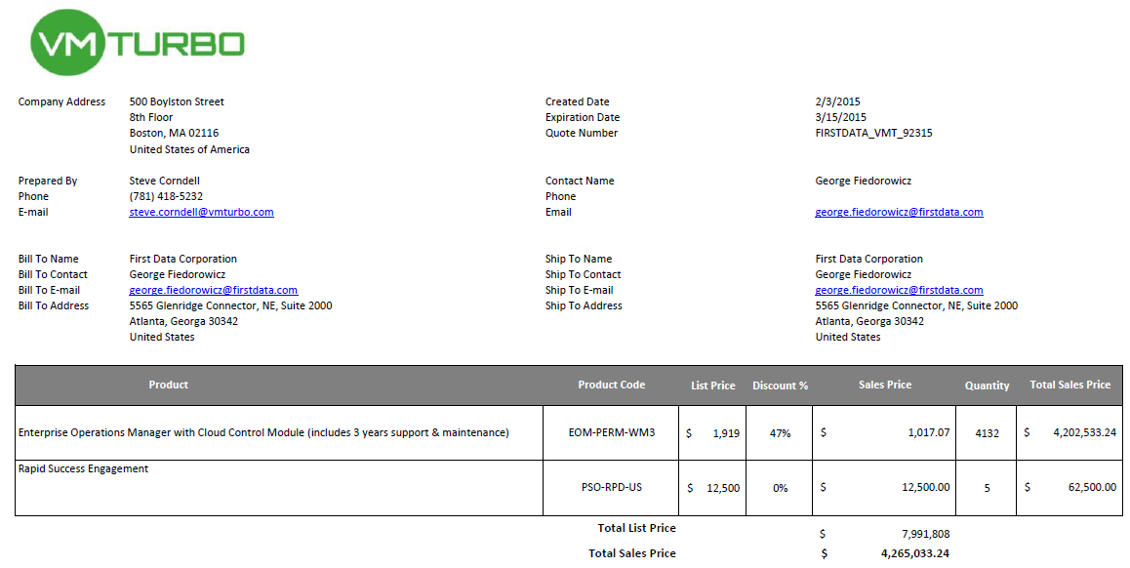
With 3 Years Support & Maintenance

Slide 43
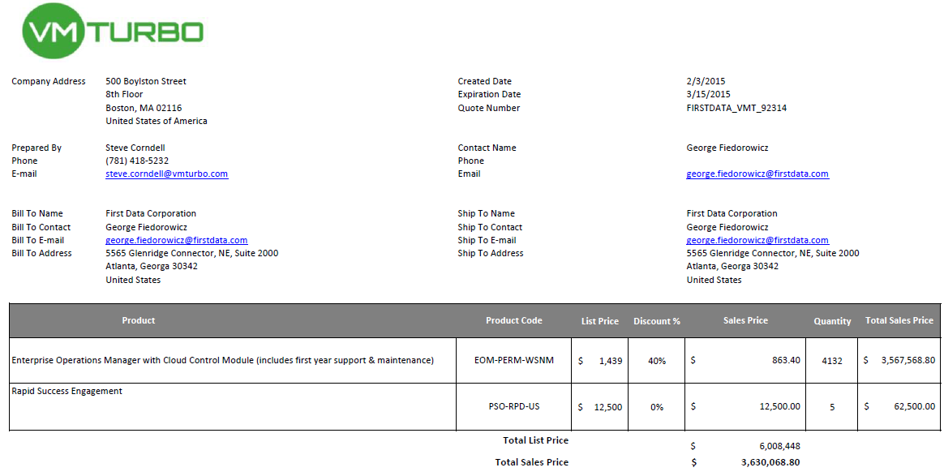
With 1 Year Support & Maintenance

Slide 44
Call to action
No more outages due to performance
Improved Operational resiliency
Better utilization of existing infrastructure
Significant reduction in future HW & SW spend
Increased team productivity
Accurate planning of future spends
Platform design engineering
Capacity Management
Service Delivery & Other Groups
VMTurbo enables unified cross functional team based results

Slide 45
Software License Agreement
First Data & VMTurbo Software License Agreement edits are complete.
Jeff Philips, Mike Familetti, and Erica McClinton (First Data)
Mo Garad, Newt Davis (VMTurbo)

Slide 46
Agenda:
First Data’s Business Challenges
First Data’s Key Requirements to meet these challenges
POV Overview
ROI Presentation
VMTurbo Competitive comparison
Proposal Discussion
Appendix (ROI Numbers confirmed through plans)

Slide 47
Appendix:
ROI inputs from First Data & VMTurbo data summary from POV
Individual Cluster projections
Contact information

Slide 48
Testing VMTurbo: Return on Investment
First Data inputs:
# of VMs: 7109
# of Physical Machines: 748
Average Cost of a host: $11,200
Software cost per host: $3,000*
Growth: 20%
Plans ran form VMTurbo
Average VM / Host Density:
51%
See Slide for cluster projections ran
Power off 100 Hosts!
ms
Savings
Optimal Operating Zone
Desired State
DELAY
QoS Guarantee
Current State
0%
UTILIZATION
100%
*estimated

Slide 49
Appendix:
ROI inputs from First Data & VMTurbo data summary from POV
Individual Cluster projections
Contact information

Slide 50
Testing VMTurbo: Cluster Projections ran

Slide 51
Testing VMTurbo: Cluster Projections ran

Slide 52
Testing VMTurbo: Cluster Projections ran

Slide 53
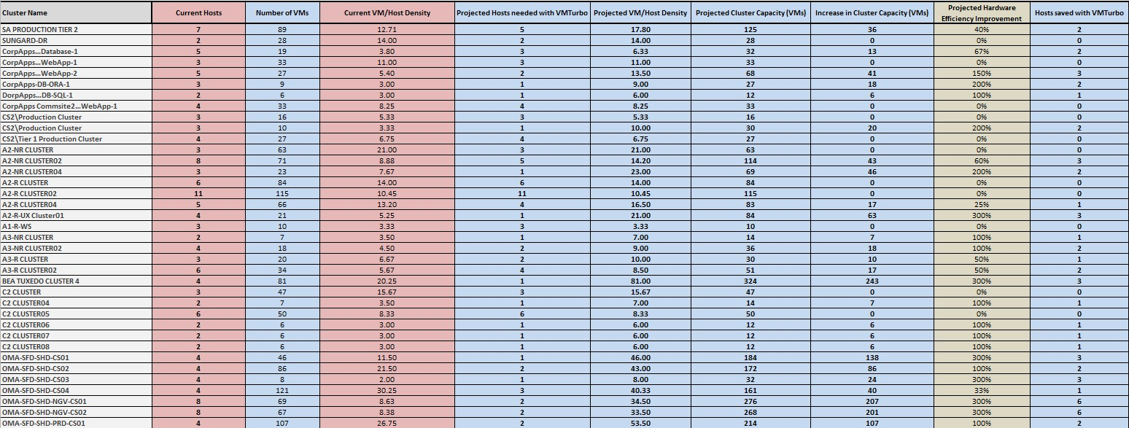
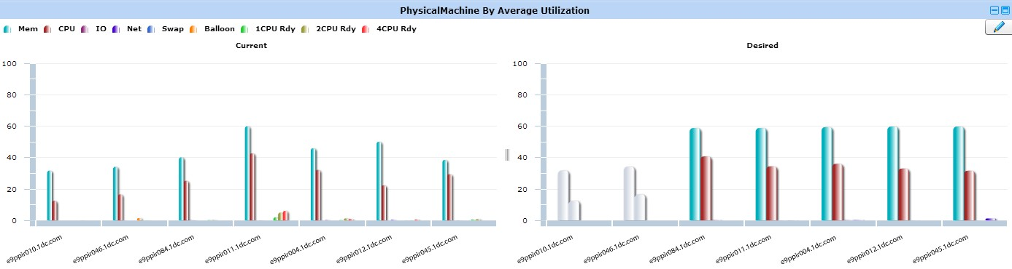
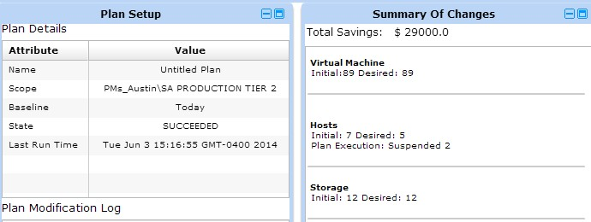
Testing VMTurbo: Cluster Projections ran

Slide 54
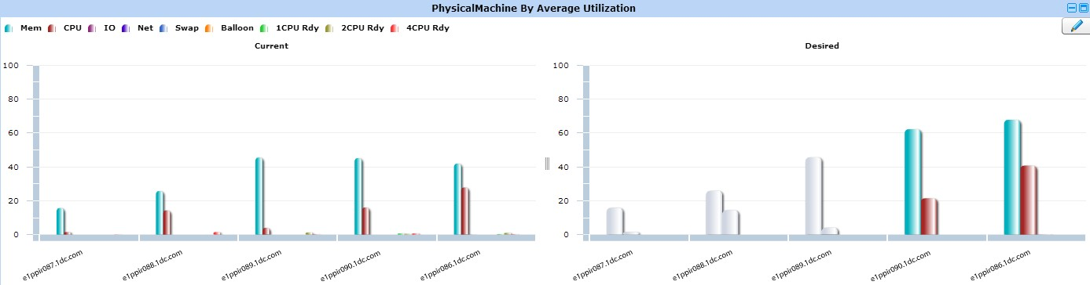
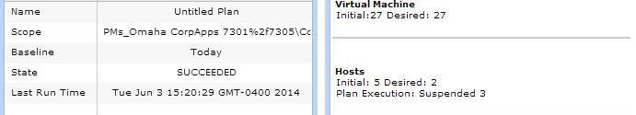
Testing VMTurbo: Cluster Projections ran

Slide 55
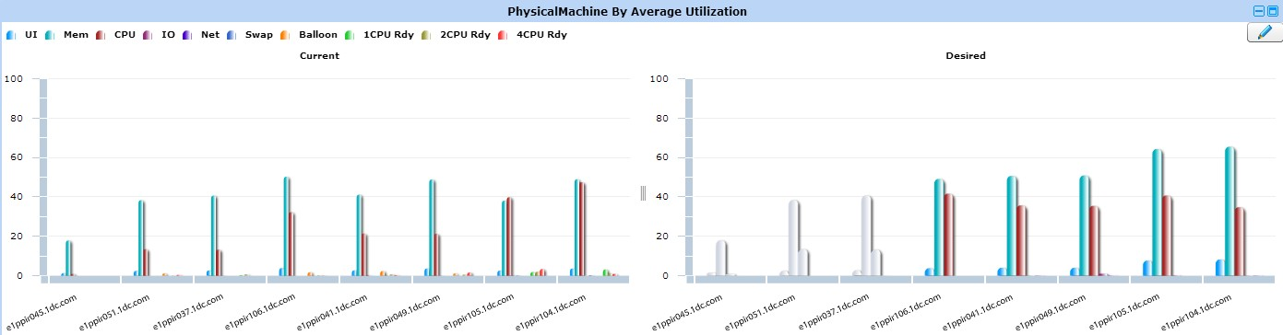
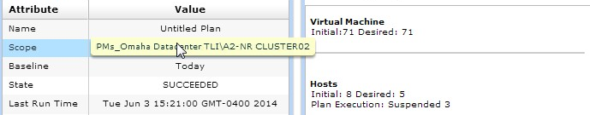
Testing VMTurbo: Cluster Projections ran

Slide 56
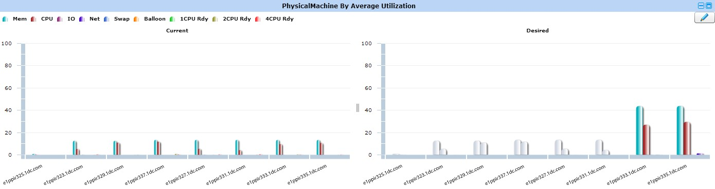
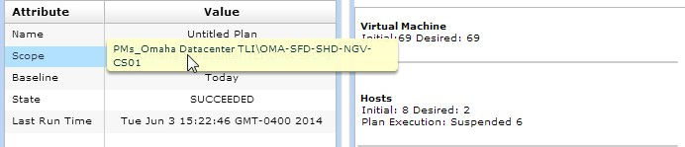
Testing VMTurbo: Cluster Projections ran

Slide 57
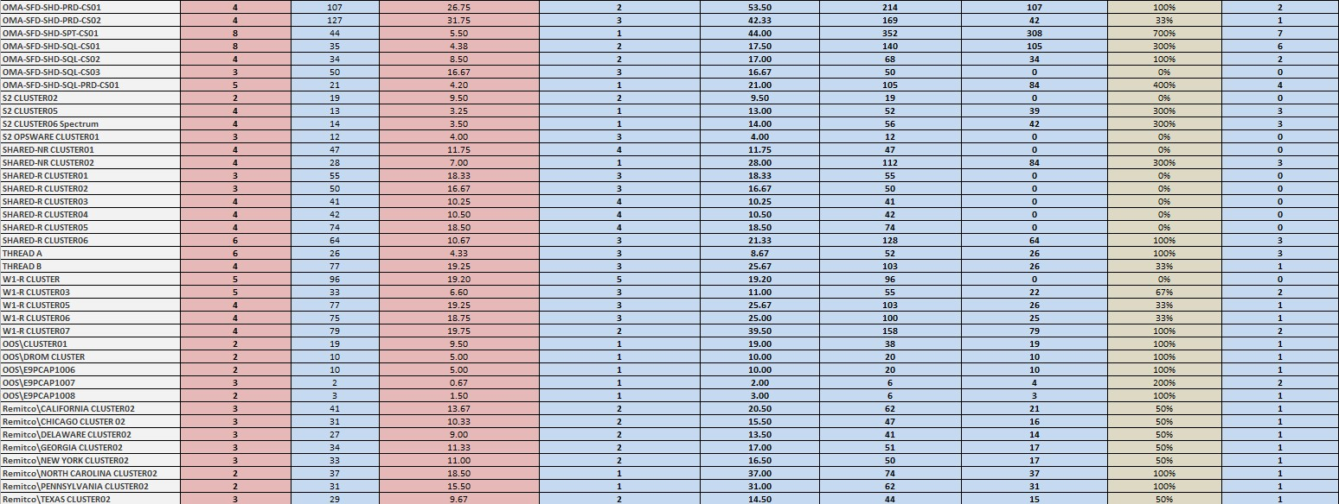

Testing VMTurbo: Cluster Projections ran

Slide 58
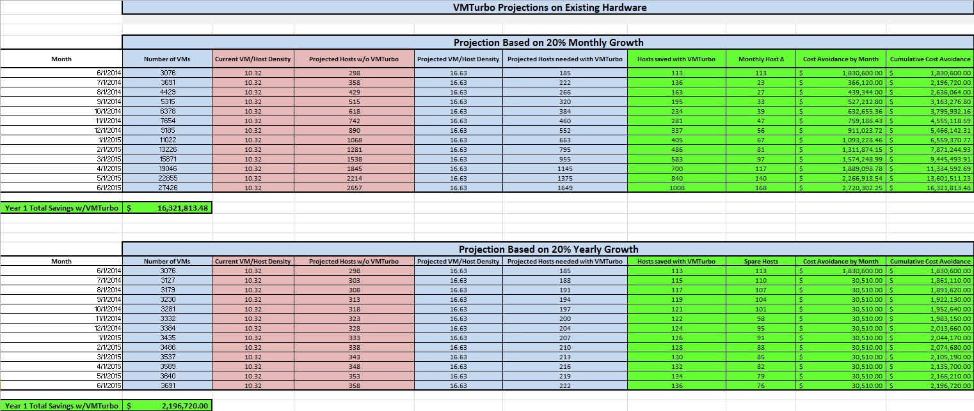
Testing VMTurbo: Cluster Projections ran

Slide 59
Appendix:
ROI inputs from First Data & VMTurbo data summary from POV
Individual Cluster projections
Contact information

Slide 60
Contact us
Steve Corndell – Primary contact for First Data Phone: 774-273-0056 Email: steve.Corndell@vmturbo.com
Oved Lourie – Lead Engineer for First Data Phone: 978-828-5989 Email: Oved.Lourie@vmturbo.com
Ben Nye – CEO of VMTurbo Phone: 866-634-5087 Email: ben.nye@vmturbo.com
THANK YOU!
Jim McInerny– VP of Sales Phone: 781-367-3880 Email: Jim.Mcinerny@vmturbo.com
Shmuel Kliger – Founder Email: Shmuel.Kliger@vmturbo.com

